Slide 1


Slide 2

CAPSTONE
PROJECT TITLE –
APPOINTMENT NO-SHOW UP
By Aditi Chugh

Slide 3
Problem Statement
A person makes a doctor appointment, receives all the instructions and no-show. Who to blame? The most important one if the patient show-up or no-show to the appointment.
Inspiration: What if that possible to predict someone to no-show an appointment?
The problem statement is centered around determining who is to blame when a patient schedules a doctor appointment but then fails to show up. This issue can have significant implications for healthcare providers, including financial losses and operational inefficiencies. By understanding the factors contributing to missed appointments, healthcare providers can take proactive measures to mitigate this problem and improve patient care.

Slide 4
Project Details
This data analysis project explores factors influencing patient attendance at medical appointments.
Through thorough data wrangling and visualization techniques, it uncovers insights into demographics, appointment specifics, and medical conditions.
Key findings include the impact of age groups, neighborhood disparities, and factors like scholarships and SMS reminders.
By providing actionable insights, the project aims to help healthcare facilities optimize appointment scheduling and reduce patient no-shows.
By getting to know more from article provided : https://en.wikipedia.org/wiki/Bolsa_Fam%C3%ADlia

Slide 5
Project Overview: This project focuses on analyzing a dataset related to medical appointments. The primary goal is to understand the factors that affect whether patients attend their scheduled appointments or not. The dataset contains information about various aspects, including patient demographics, appointment details, and medical conditions.
Data Import and Cleaning: The project starts by importing essential Python libraries for data analysis, such as Pandas, NumPy, Matplotlib, Seaborn, and datetime. Then loads a dataset from a CSV file and performs initial data exploration.
Data Modification: The project standardizes date and time information, converting them into a consistent format. It calculates the weekdays for both the scheduled day and appointment day and assigns them numerical values (0 for Monday, 1 for Tuesday, and so on) for further analysis. Some column names are also renamed to make them more consistent and understandable.
Data Exploration and Visualization: The project involves in-depth data exploration and visualization. Begins with a bar chart showing the distribution of the target variable, "NoShow," which represents whether patients attended their appointments (Yes or No). The percentages of appointments with and without no-shows are also calculated and displayed.
Handling Missing Data: Checks for missing data, but finds none in this dataset. Mention the general guidelines for dealing with missing data, such as regression imputation for features with few missing values and considering dropping columns with a high percentage of missing values.
Data Cleaning: While no missing data is present, the project demonstrates how to group data, as in the case of age groups, by defining labels and removing the original "Age" column.
Data Exploration Continues: Proceeds to explore the dataset more deeply, displaying the counts and distributions of various features in relation to the "NoShow" variable. This provides insights into how factors like gender, age groups, neighborhood, scholarship status, hypertension, diabetes, and SMS reminders relate to appointment attendance.
Data Transformation: The "NoShow" column is converted into binary values (0 and 1) to facilitate predictive modeling or correlation analysis.
Dummy Variables: Creates dummy variables for each categorical features, (which is a common step in preparing data for machine learning models).
Correlation Analysis: Then performs correlation analysis to understand the relationships between all predictors and the "NoShow" variable. This is visualized through bar plots and a heatmap, allowing for a quick assessment of which features may be more influential in predicting no-shows.
Bivariate Analysis: Explores specific relationships, such as the impact of hypertension or age group on no-shows. To visualizes these relationships using count plots.

Slide 6
Target Variables and Dependent Variables
Target Variable
No-show-factors influencing whether patients attend their scheduled appointments or not.
Predictor Variables/Independent Variables
AppointmentID - Identification number for each appointment.
Gender - Gender of the patient.
ScheduledDay - The day the appointment was scheduled.
AppointmentDay - The day of the actual appointment. Age
Neighbourhood - Location where the appointment takes place.
Scholarship - Indicates whether the patient is enrolled in a scholarship program.
Hipertension - Indicates whether the patient has hypertension.
Diabetes - Indicates whether the patient has diabetes.
Alcoholism – Indicates whether the patient is an alcoholic or not.
Handcap -
SMS_received

Slide 7
Article Summary
The article discusses the Bolsa Família program, which is a social welfare initiative implemented by the Brazilian government as part of its efforts to alleviate poverty. Started in 2003 under President Luiz Inácio Lula da Silva, Bolsa Família provides financial aid to poor families, contingent upon conditions such as ensuring children attend school and receive vaccinations. The program aims to reduce both short-term and long-term poverty by providing direct cash transfers and promoting human capital development among the poor.
Initially praised as an effective anti-poverty measure, Bolsa Família has faced criticism and controversy, with opponents arguing that it could discourage employment and perpetuate dependency. However, research indicates that the program has contributed to significant improvements in education, health, and economic outcomes for beneficiaries. It has also been credited with reducing child labor, improving food security, and lowering suicide rates in Brazil.
Despite its successes, Bolsa Família has been subject to political debates and underwent changes over the years, including the introduction of new programs and modifications to eligibility criteria and benefit amounts. Overall, the article highlights both the achievements and challenges of Bolsa Família in tackling poverty and inequality in Brazil

Slide 8

Scholarship and Bolsa Family
The problem statement aligns closely with the concerns raised in the article. Both emphasize the negative impact of missed appointments on healthcare providers and the need for effective solutions to address this issue. Analyzing the dataset provided in the context of the article can help identify factors contributing to missed appointments and inform strategies to mitigate this problem, ultimately improving healthcare delivery and patient outcomes.

Slide 9
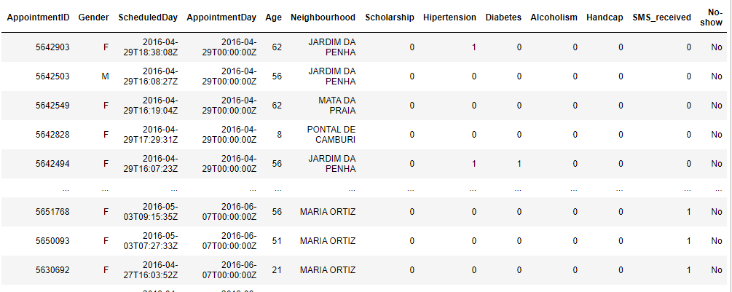
Dataset
This dataset, containing over 110,000 patient appointments, embarks on a quest to solve the medical no-show mystery. Packed with 13 crucial data points, we delve beyond the surface, examining not just dates and demographics but also socioeconomic indicators like scholarship status. We even explore potential health concerns like hypertension, diabetes, and alcoholism. Most importantly, we track the crucial outcome: did the patient show up?

Slide 10
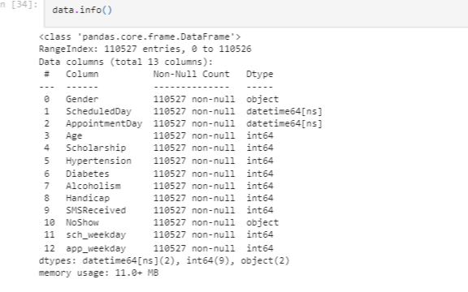
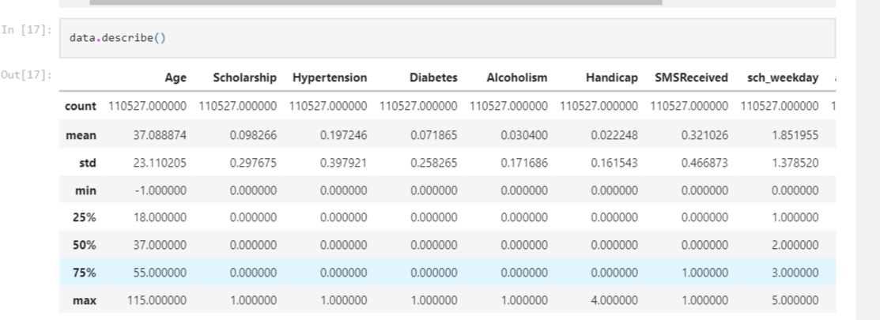
Data Type and Description of Data
Observations
We can check that most of the values are in numerical form.
We can check the mean, standard deviation, total counts, min-max of the numerical columns
We can also check the data distribution as per quartile.

Slide 11
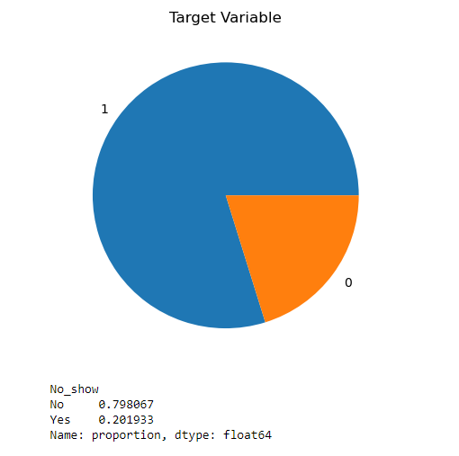
Balancing of the DataSet

Slide 12
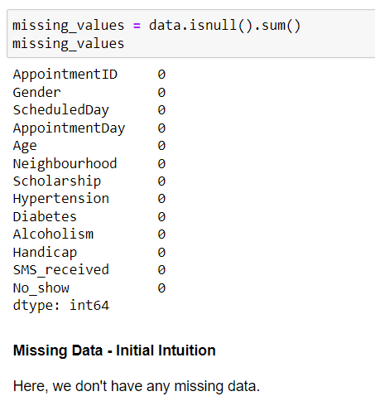
Missing Values
Observations
We have 0% missing values both in our independent variables as well as dependent variables.
For features with less missing values- can use regression to predict the missing values or fill with the mean of the values present, depending on the feature.
As there's no thumb rule on what criteria do we delete the columns with high number of missing values, but generally you can delete the columns, if you have more than 30-40% of missing values.

Slide 13

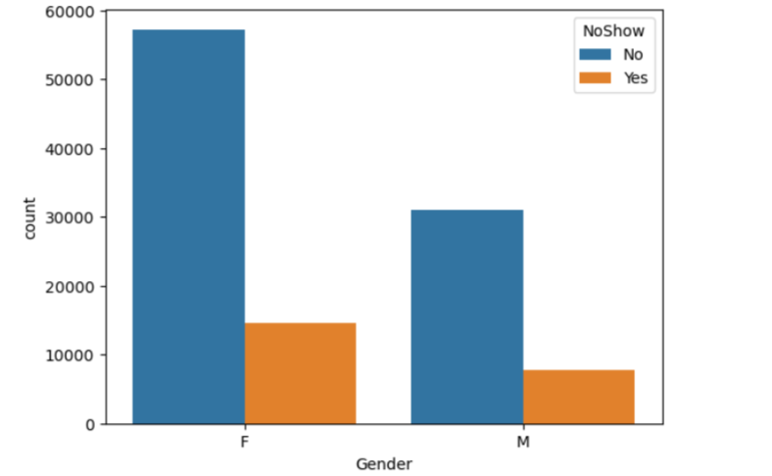
Gender No-Show distribution
Observations:
As per the graph the income distribution follows modified normal distribution
Female patients have taken more appointments then male patients.
In Gender distribution Females have attended at the higher number.

Slide 14

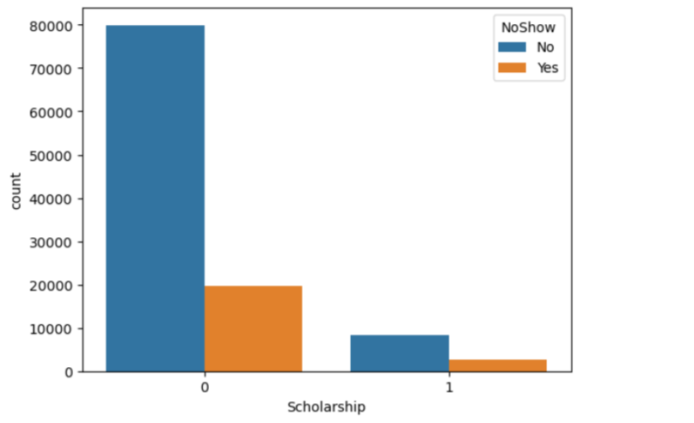
Scholarship Distribution
Observations:
There are 99666 patients without Scholarship and out of them around 80% have come for the visit and out of the 21801 patients with Scholarship around 75% of them have come for the visit.

Slide 15

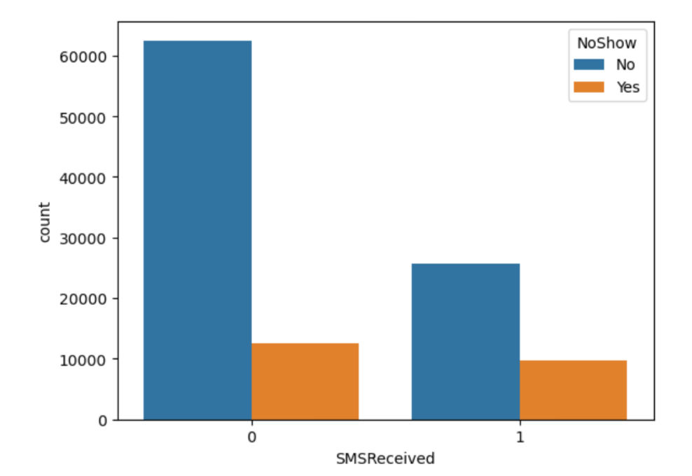
SMS RECEIVED OR NOT?
Observation :
There are around 75,045 patients who have not received SMS and out of them around 84% have come for the visit and out of the 35,482 patients who have received SMS around 72% of them have come for the visit.

Slide 16
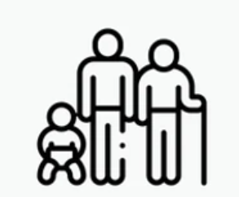
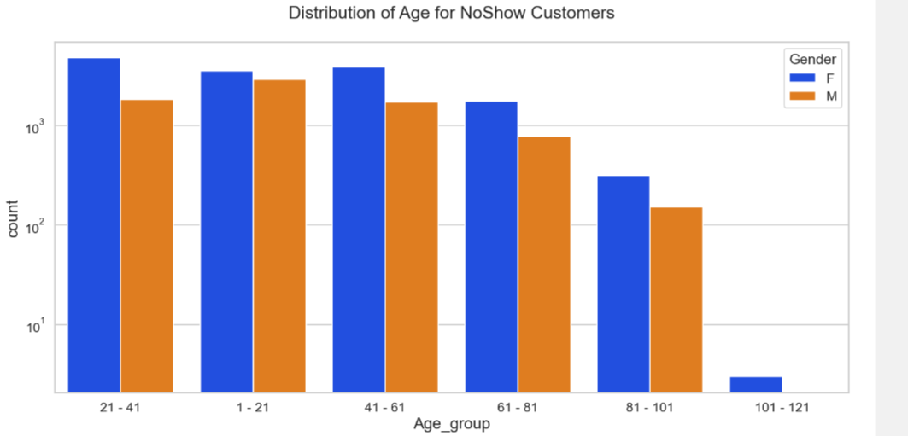
Age Group Distribution
Observations:
Ratio of No Show and Show is almost equal for age group except Age 0 and Age 1 with 80% show rate for each age group.

Slide 17
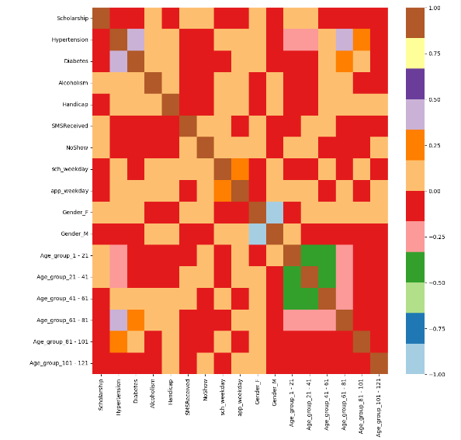
Correlation Heatmap
Observations:
It is important to remember that correlation does not equal causation. Just because two factors are correlated does not mean that one causes the other.
The heatmap only shows correlations between pairs of factors.
Strong positive correlations (red squares):
Age group 41-61 and no-shows: This suggests that patients between the ages of 41 and 61 are more likely to miss their appointments than other age groups.
Moderate positive correlations (orange squares):
Age group 61-81 and no-shows: This suggests that patients between the ages of 61 and 81 are somewhat more likely to miss their appointments than other age groups.
Weak positive correlations (yellow squares):
Gender_M and no-shows: This suggests that men are slightly more likely to miss their appointments than women.
No-Correlation(White Squares)

Slide 18
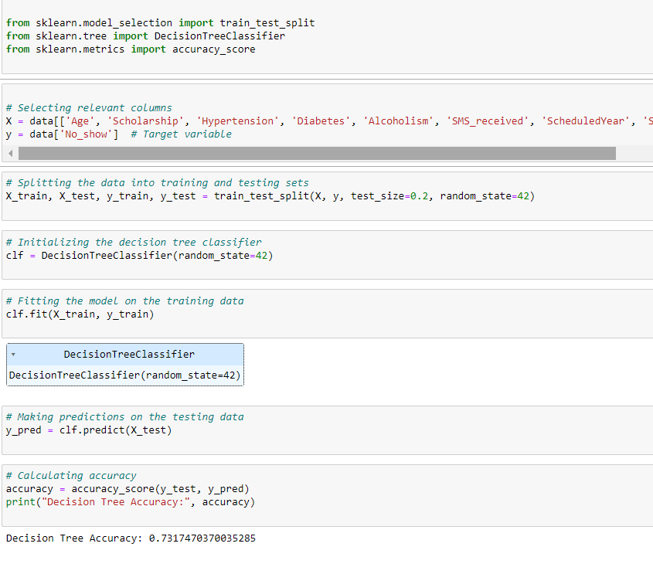
Model Building
For features with less missing values- can use regression to predict the missing values or fill with the mean of the values present, depending on the feature.
A decision tree is a supervised learning algorithm used for classification and regression tasks. In regression, the decision tree predicts a continuous value for each instance. The choice between classification and regression depends on the nature of the target variable you are trying to predict.

Slide 19
CONCLUSION/ INSIGHTS
Female patients have taken more appointments then male patients.
Ratio of NoShow and Show is almost equal for age group except Age 0 and Age 1 with 80% show rate for each age group
Each Neighbourhood have almost 80% show rate
There are 99666 patients without Scholarship and out of them around 80% have come for the visit and out of the 21801 patients with Scholarship around 75% of them have come for the visit.
There are around 88,726 patients without Hypertension and out of them around 78% have come for the visit and Out of the 21801 patients with Hypertension around 85% of them have come for the visit.
There are around 102,584 patients without Diabetes and out of them around 80% have come for the visit and Out of the 7,943 patients with Diabetes around 83% of them have come for the visit.
There are around 75,045 patients who have not received SMS and out of them around 84% have come for the visit and out of the 35,482 patients who have received SMS around 72% of them have come for the visit.
There is no appointments on sunday and on saturday appointments are very less in comparision to other week days.

Slide 20
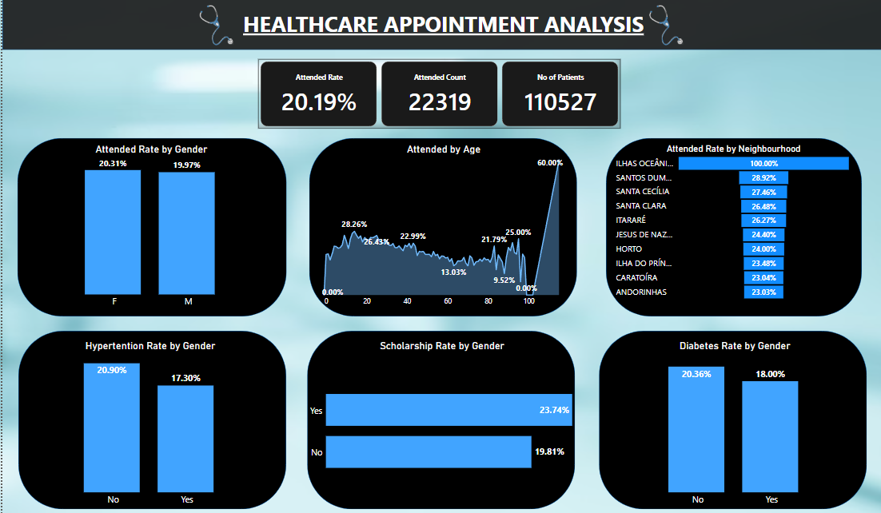
PowerBI Dashboard

Slide 21
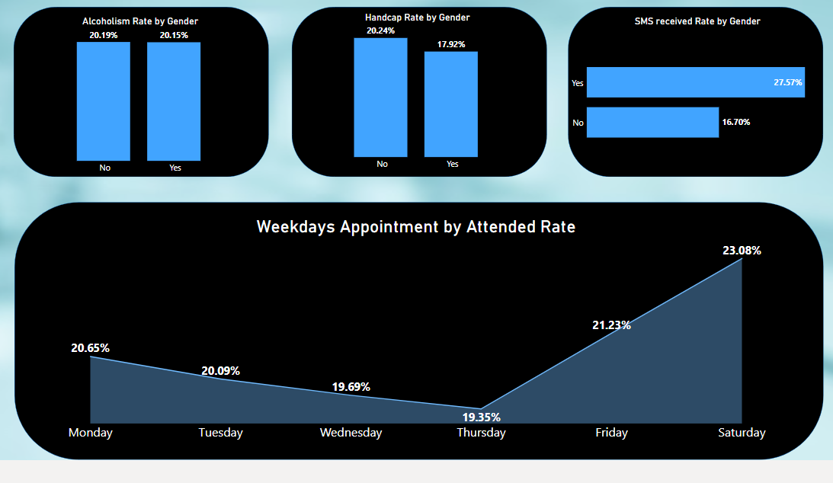
PowerBI Dashboard

Slide 22
Thank You!!

